Slide 1
Production and Protection Initiative
Brief Presentation for Norad
28 October 2013
Jane Wilkinson, Director, Indonesia Program

Slide 2
Production and Protection - Assumptions
Opportunity exists to grow the rural economy in Indonesia in a way that reduces costs and impacts (economic, social and environmental).
Land use optimization is key –ie, shifting environmentally suitable, low productivity land into higher productivity uses.
Increased productivity can be achieved at the same time as conserving scarce resources and environmental services, including through appropriate land zoning and better protection policies for high value ecosystems.
A strengthened system of financial incentives that shares the benefits equitably will be key to realizing this potential.
Notes:
The Central Kalimantan Production - Protection Initiative is a partnership between the Climate Policy Initiative (CPI) and University of Palangka Raya (UNPAR) that supports the Government of Central Kalimantan’s vision to optimize land use and build a sustainable palm oil sector.
Production - Protection is an innovative approach to the allocation and management of land resources. It aims to reconcile the need to achieve strong economic growth, particularly in Indonesia’s agricultural sector, while ensuring development is environmentally sustainable and protects high value ecosystems or ‘natural capital’. This approach recognizes that enforcement of environmental constraints at the cost of economic growth is unachievable. It is therefore premised upon 4 assumptions.

Slide 3
Approach for 2013
Provincial Capacity Development - establishing support mechanisms in Central Kalimantan to facilitate and coordinate policy development
  Core Working Group
  Secretariat
  Centre of Excellence
  Recruitment of core staff & senior technical advisors.
Analytical Work
Notes:
Outputs for 2013
Provincial Capacity Development
Output 1: Establishment of a permanent Secretariat hosted by UNPAR
Output 2: Core Working Group: The working group has been established by Governor‘s Decree. They will convene in late November 2013 to review outputs from the 2013 analytical work program and to formally endorse the forward work program for 2014.
Output 4: Center of Excellence: physically established at UNPAR. The Secretariat will be co-located within the Centre. yet to be established as a legal entity that is capable of directly receiving and managing a component of the Norad grant funding
Analytical work:
the current status of spatial planning;
business practices and yield variation of oil palm companies operating in Central Kalimantan; and
fiscal flows associated with oil palm which shape land management and investment decisions.

Slide 4
Land Use Optimisation - Mapping
  Phase 1 – Information collection
  Phase 2 – Depth analysis and gap filling
  Phase 3 – Knowledge translated to policy
  Phase 4 – Implementation

Slide 5
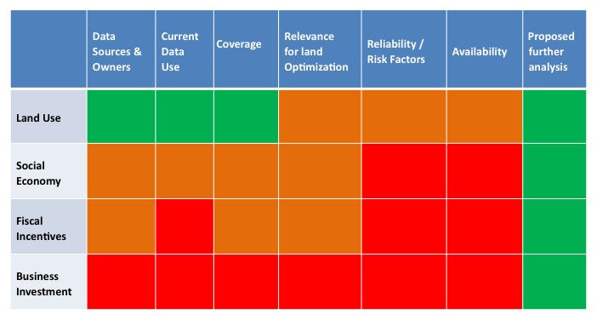
Data mapping for Central Kalimantan
Notes:
Phase I: Mapping Land Optimization Data Availability and Gaps
To develop a business model for investment in sustainable oil palm a good understanding of land optimization opportunities in Central Kalimantan is required. To build this understanding, UNPAR and CPI will prepare a comprehensive map of existing information sources and key information gaps relating to four themes:
Land use - including natural ecosystems and other current or planned land uses;
Social economy - including location of population and indigenous land claims;
Business investments in key agricultural sectors - including palm oil; and
Fiscal incentives and flows impacting on land use.
This is an indicative table of available information and gaps.
This is a preliminary assessment only, with green indicating good existing information, or significant further analysis recommended. Orange indicates some information is available but is incomplete. Red indicates limited information is available.)

Slide 6
Land Use Analysis – Brazilian example (2011)
554 million ha native vegetation
107 million ha Conservation Units
103.5 million ha Indigenous Lands
274 million ha native vegetation within private property (water and hillside Areas of Permanent Protection; Legal Reserves)
69.5 million ha remaining native vegetation
60 million ha productive area
Grain, fruit, planted forest
38 million ha urban area and other uses
198 million ha pasture
Source: ICONE (2012)
Notes:
Phase II & III: the ‘good enough map’ and ‘business model’
By the end of phase II, UNPAR and CPI aim to develop a detailed map of opportunities for optimizing land use in Central Kalimantan, similar the work that has been supported by CPI in Brazil. This includes an understanding of what high value ecosystems exist in Central Kalimantan that would benefit from protection, and where environmentally suitable land is available for conversion to high productivity agriculture.
Phase III of cooperation between UNPAR and CPI will focus on implementation to demonstrate how production-protection opportunities can be taken-up on the ground through a practical business model. This business model is expected to involve public-private partnerships and a jurisdictional approach in cooperation with one or more suitable districts in Central Kalimantan.

Slide 7
Thank you
jane.wilkinson@cpivenice.org

