Slide 1
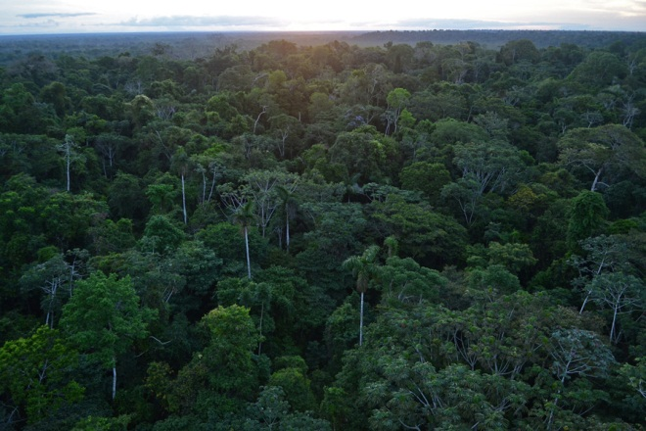

REDD COMPASS
Community-powered Assessment of Ecosystem Services and Safeguards
David Sabogal
CMRV Project Coordinator
Oslo
28 October 2013

Slide 2

CONTENT
Community-based MRV
  Role in REDD+
The REDD Compass project
  Goals
  Case-study regions

Slide 3
COMMUNITY-BASED MRV
REDD+ requires:
  Local level participation and engagement
  Reliable and credible system for MRV
  Social and environmental safeguards
CMRV offers:
  Additional, accurate and reliable source of data & information
  Promotes participation/ownership
  Cost-effective
  Promotes capacity building and cooperation
  Forest management improvements
  Strengthens rights and stake in REDD+

Slide 4
REDD COMPASS
Phase 1:
  Building local monitoring capacity
  Informing resource management decisions and engagement on REDD+
  Linking CMRV to national MRV system (demonstration site)
Participatory monitoring scheme
  Socio-economic and environmental indicators
  Balances local needs with external requirements
CMRV technology
  Handhelds
  Open Data Kit (ODK)
  Google Earth Builder

Slide 5
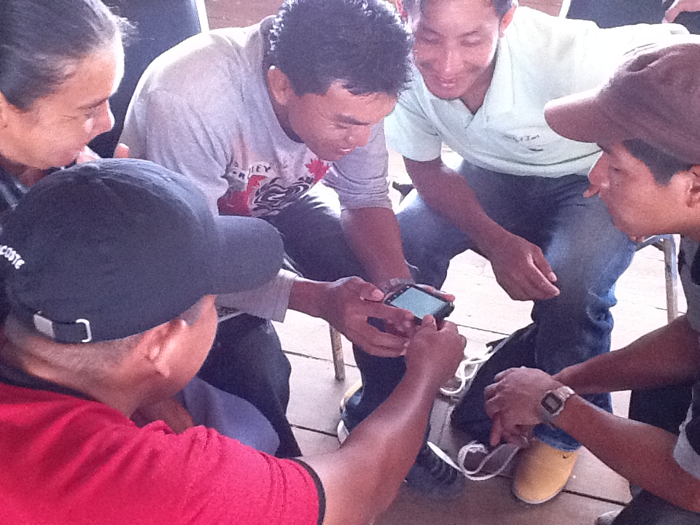

Slide 6
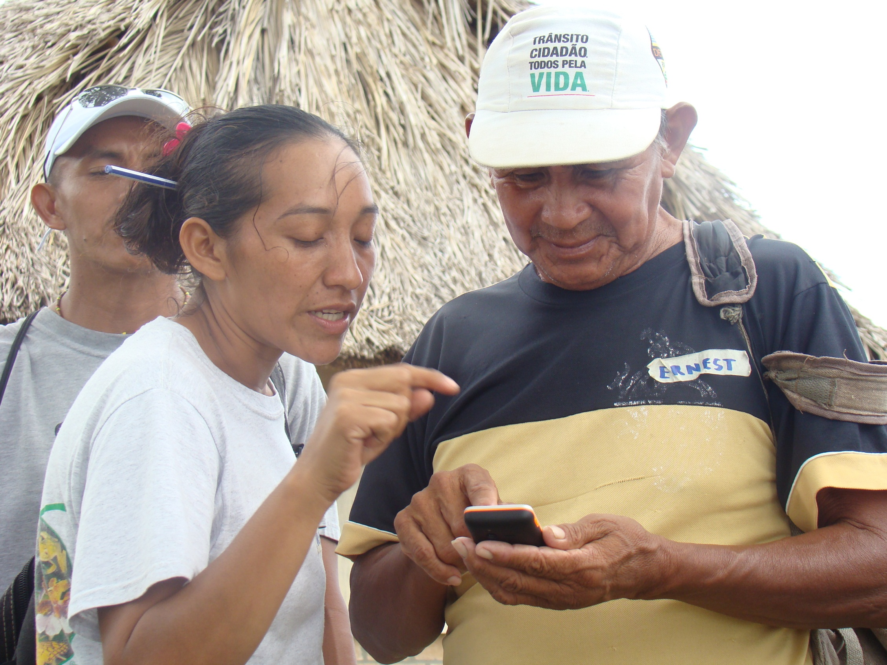

Slide 7
PROJECT GOALS:
  Community-MRV is recognised by national and international policy makers as an integral source of information for accurately and cost-effectively monitoring REDD+ activities and safeguards;
  Tropical forest communities understand the benefits and risks of REDD+, and have the knowledge and tools to take informed decisions and play a proactive and independent role in making REDD work in their territories.
Notes:
Thematic category: Analysis, concept and methodology development that contribute to planning and implementation of REDD+.

Slide 8
PROJECT STRATEGIES (Phase 2):
Consolidation of the CMRV project in the North Rupununi, Guyana
Uptake and incorporation of CMRV in national policies in Guyana
CMRV approach replicated in the Chico Mendes Extractive Reserve in Acre
Knowledge sharing network and collaborative development of CMRV best practices

Slide 9
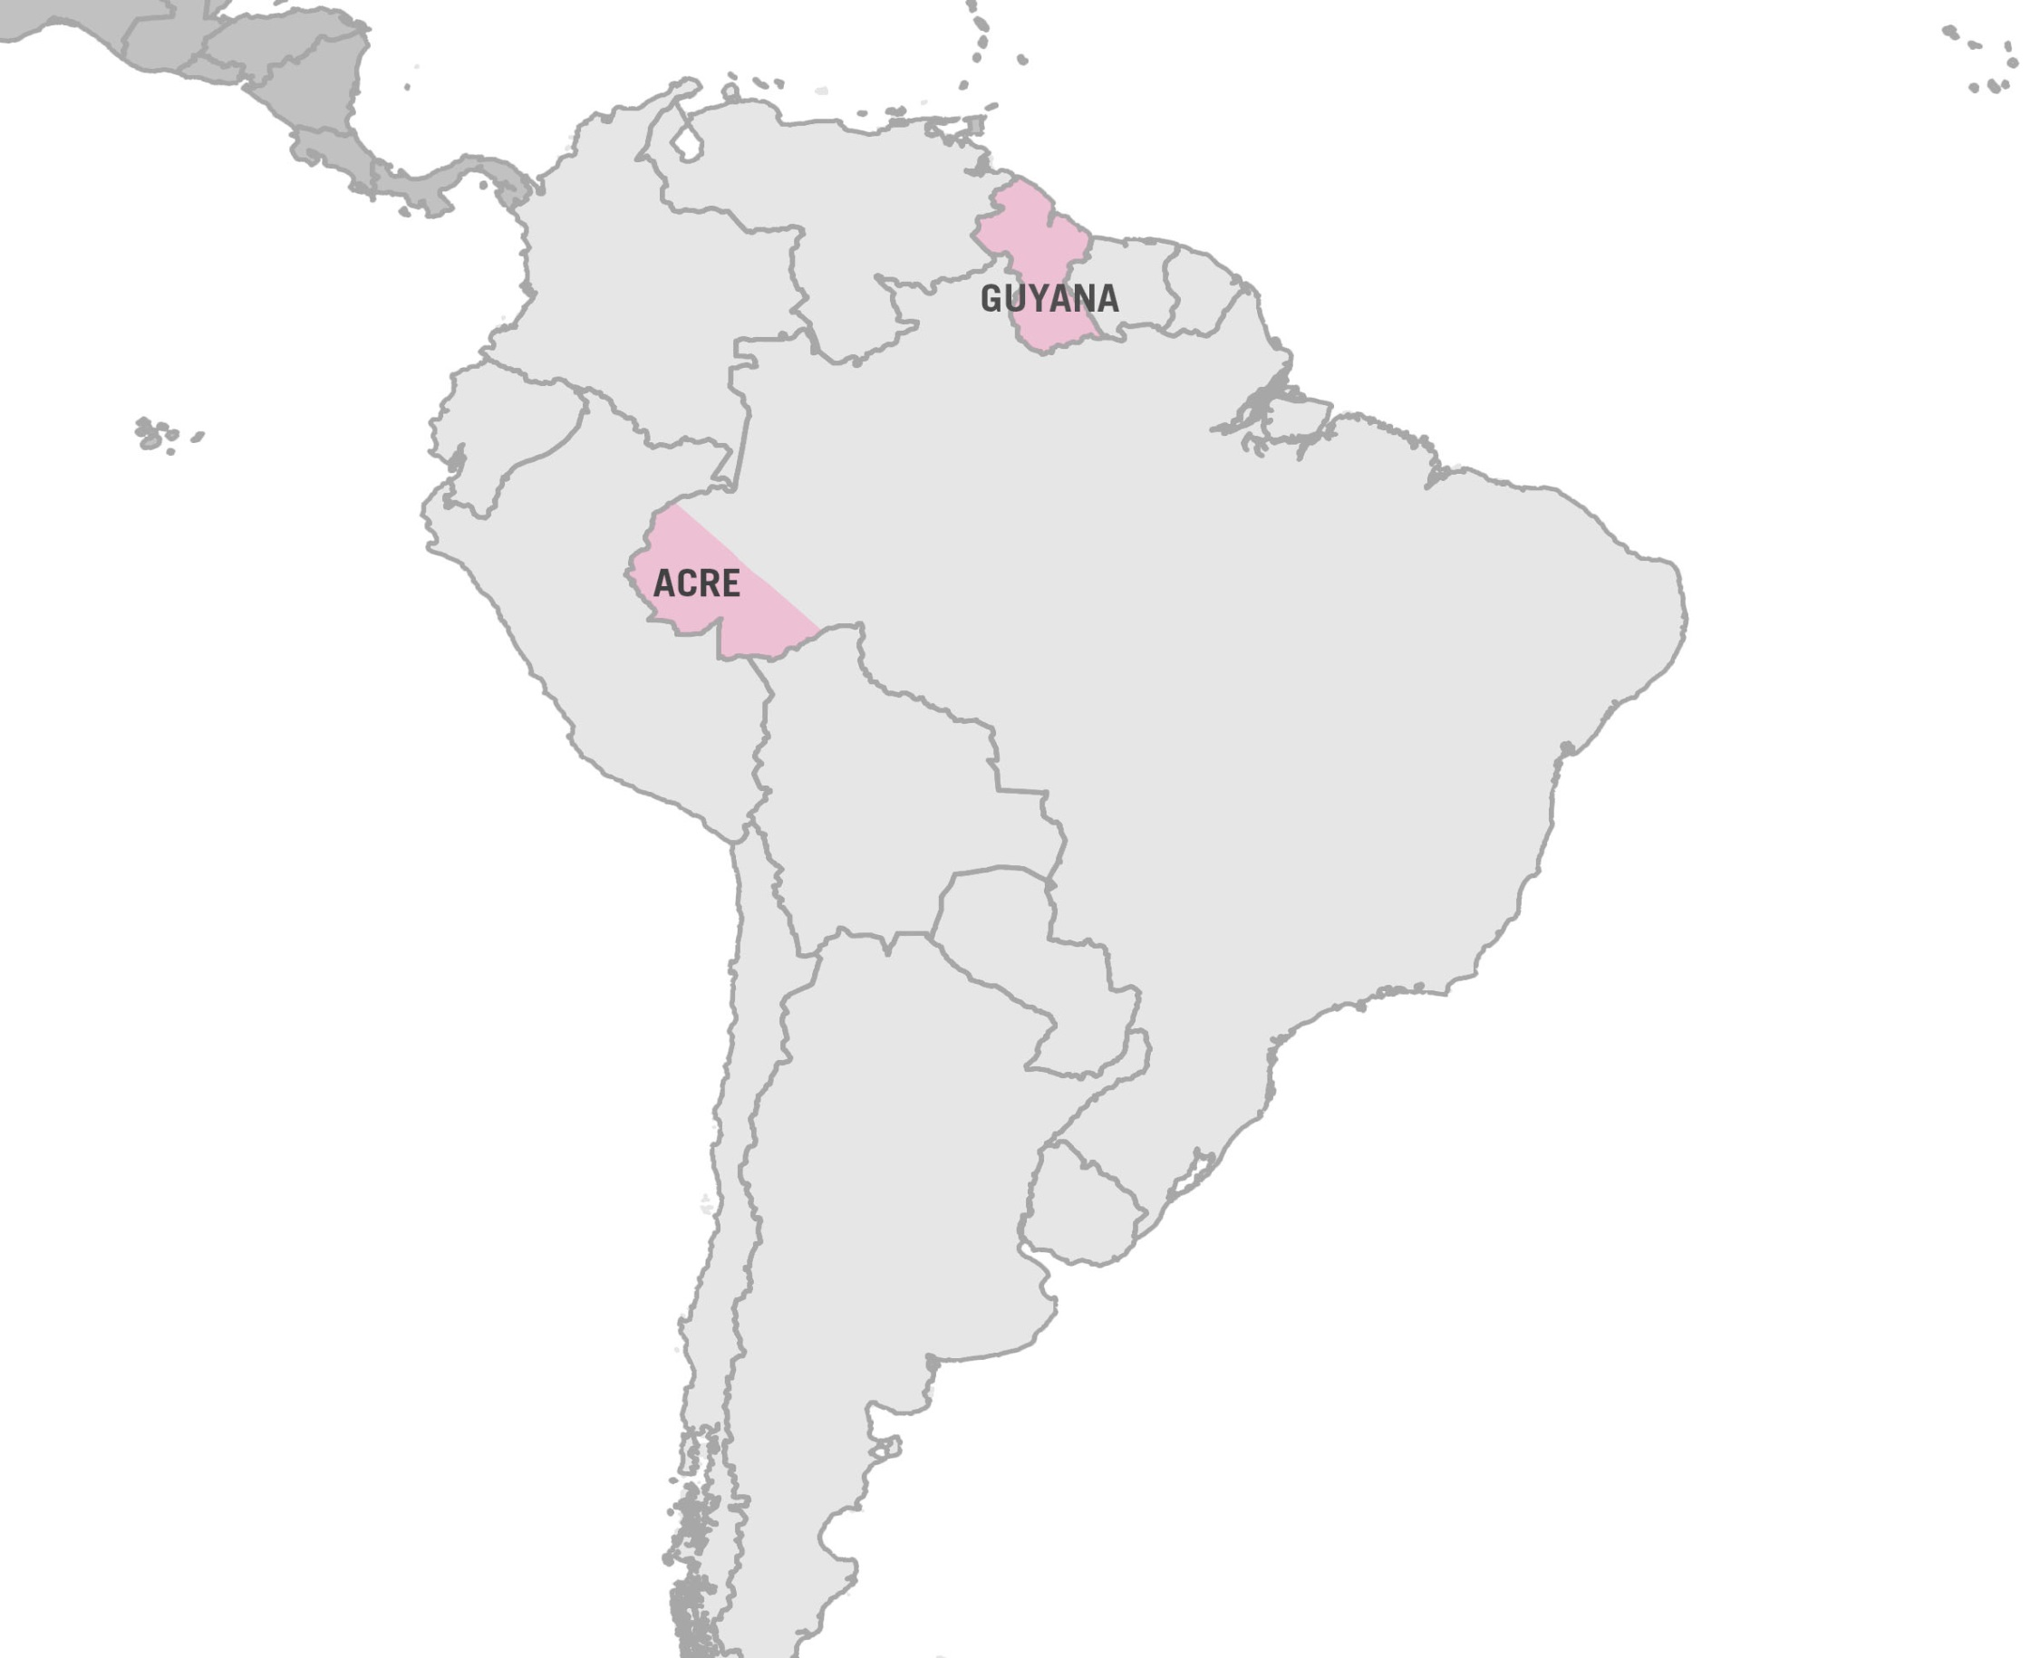

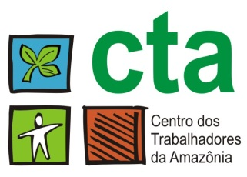
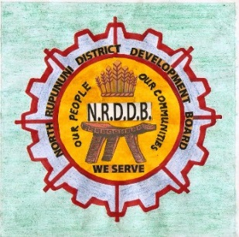
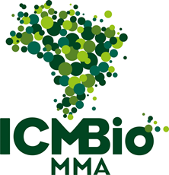

North Rupununi:
16 Makushi communities; 32 monitors + 5 project staff
Chico Mendes Extractive Reserve:
5 municipalities; 40 monitors + 3 project staff

Slide 10
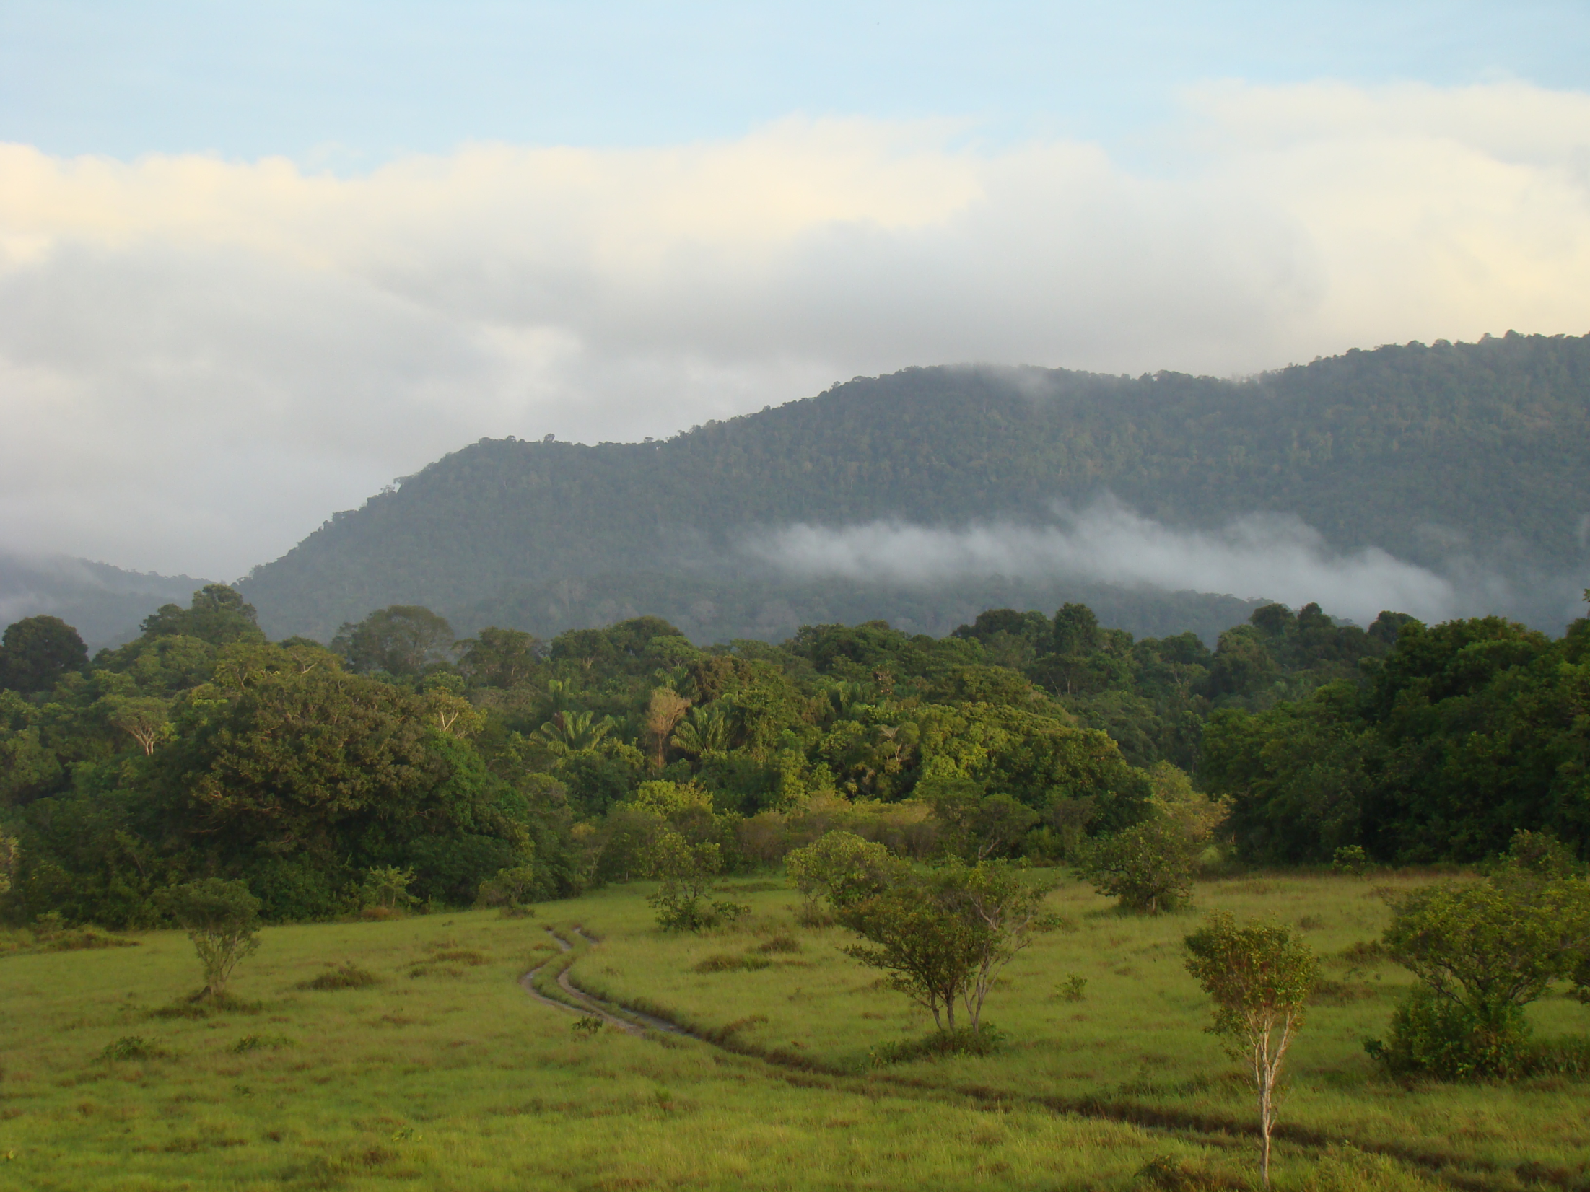
THANK YOU!
David Sabogal
CMRV Project Coordinator
d.sabogal@globalcanopy.org
www.globalcanopy.org

