Slide 1
Lighting the Path towards Gender Equality? Learning from Solar Electricity Projects in Rural Afghanistan and India
Karina Standal
PhD fellow
Centre for Development and the Environment

Slide 2
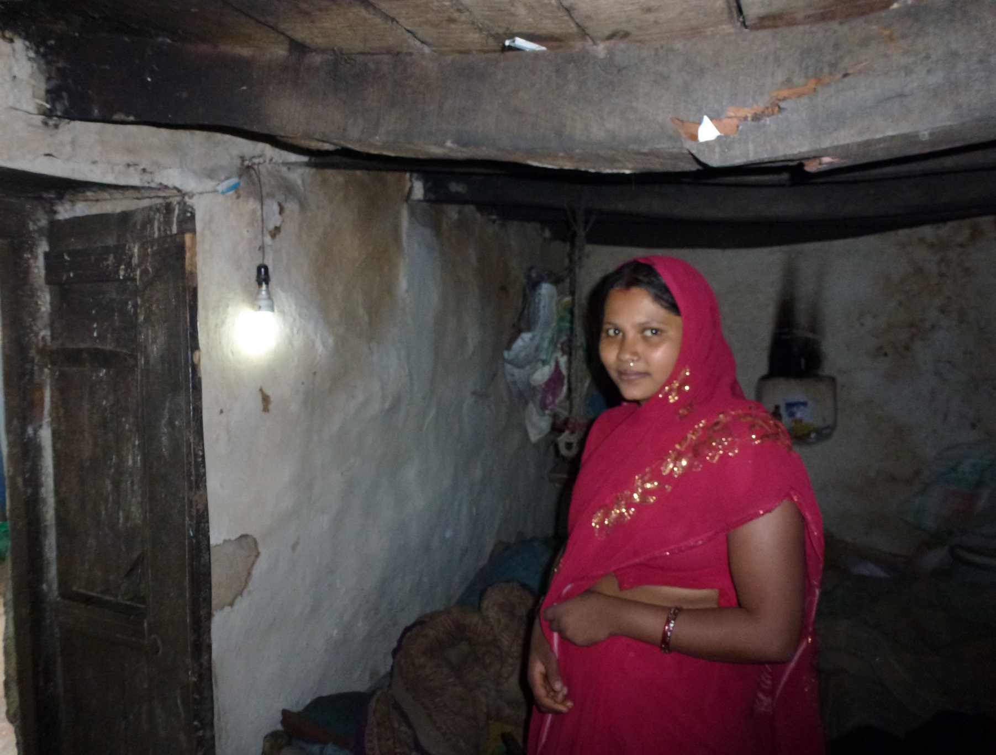
House with solar micro-grid connection in Uttar Pradesh

Slide 3
Main Research Objective
Comparison of rural solar electrification projects in India and Afghanistan in terms of impact on gender relations
Tease out best outcome in relation to gender equality and women’s rights

Slide 4
The Uttar Pradesh Case
Scatec Solar project
Solar driven micro-grids providing household lighting and sockets.
Solar driven water supply systems for household taps

Slide 5
The Uttar Pradesh Case
Establishment of Village Energy Committees (VEC) to deal with future of the project
The VEC also has women members
Local trained operator oversees repair and maintenance

Slide 6
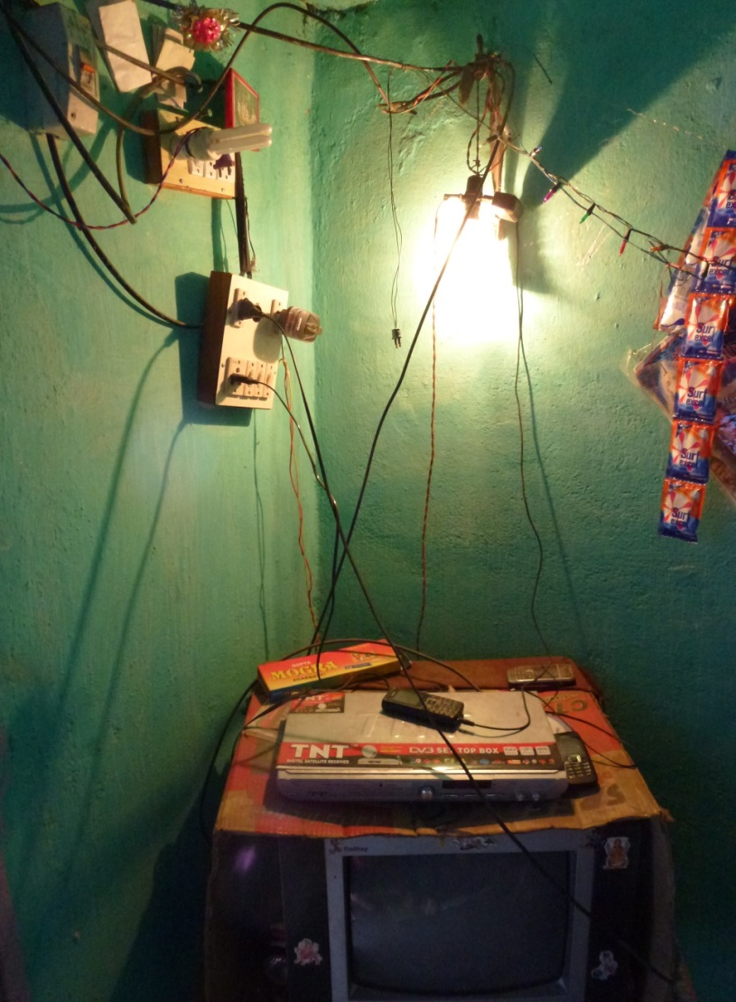
Findings Uttar Pradesh
Has not provided income opportunities
Women members of VEC not active

Slide 7
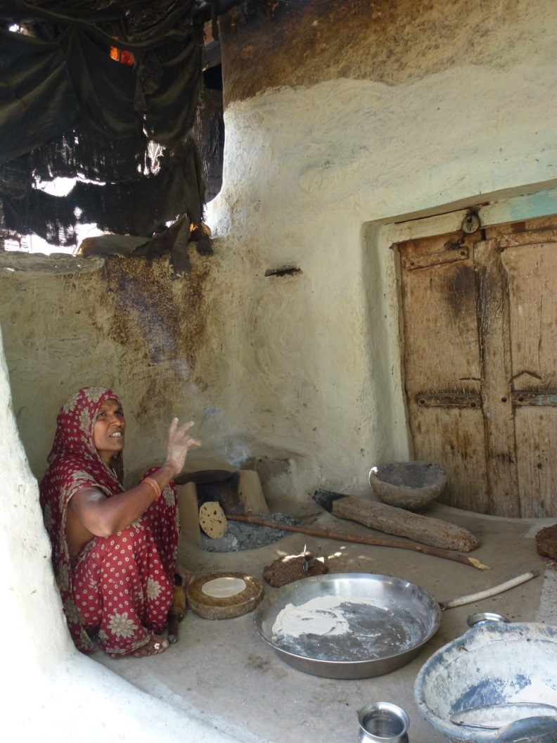
Findings Uttar Pradesh
Provide women opportunity to perform better in relation to their responsibilities
Provide women opportunity to perform better in relation to motherhood

Slide 8
The Bamiyan Case
NCA project for community driven solar energy in rural Afghanistan
Solar Home Systems providing household lighting and sockets

Slide 9
The Bamiyan Case
Community members are trained as Barefoot Solar Engineers (BSE) with responsibility for repairing and maintanance
Women are targeted as desired BSEs

Slide 10
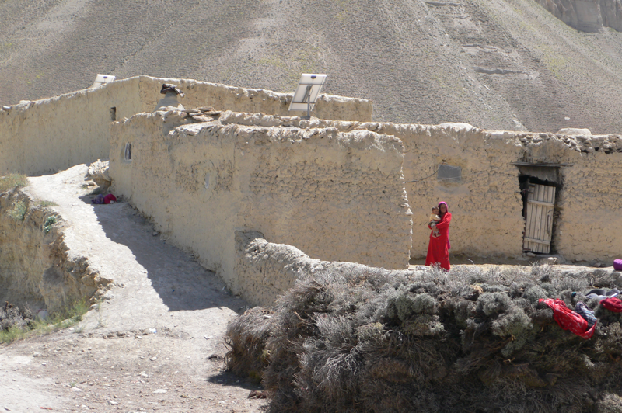
Findings Bamiyan
Improved income opportunities
New mobility for women within the village
Access to information on WRGE from TV/Radio

Slide 11
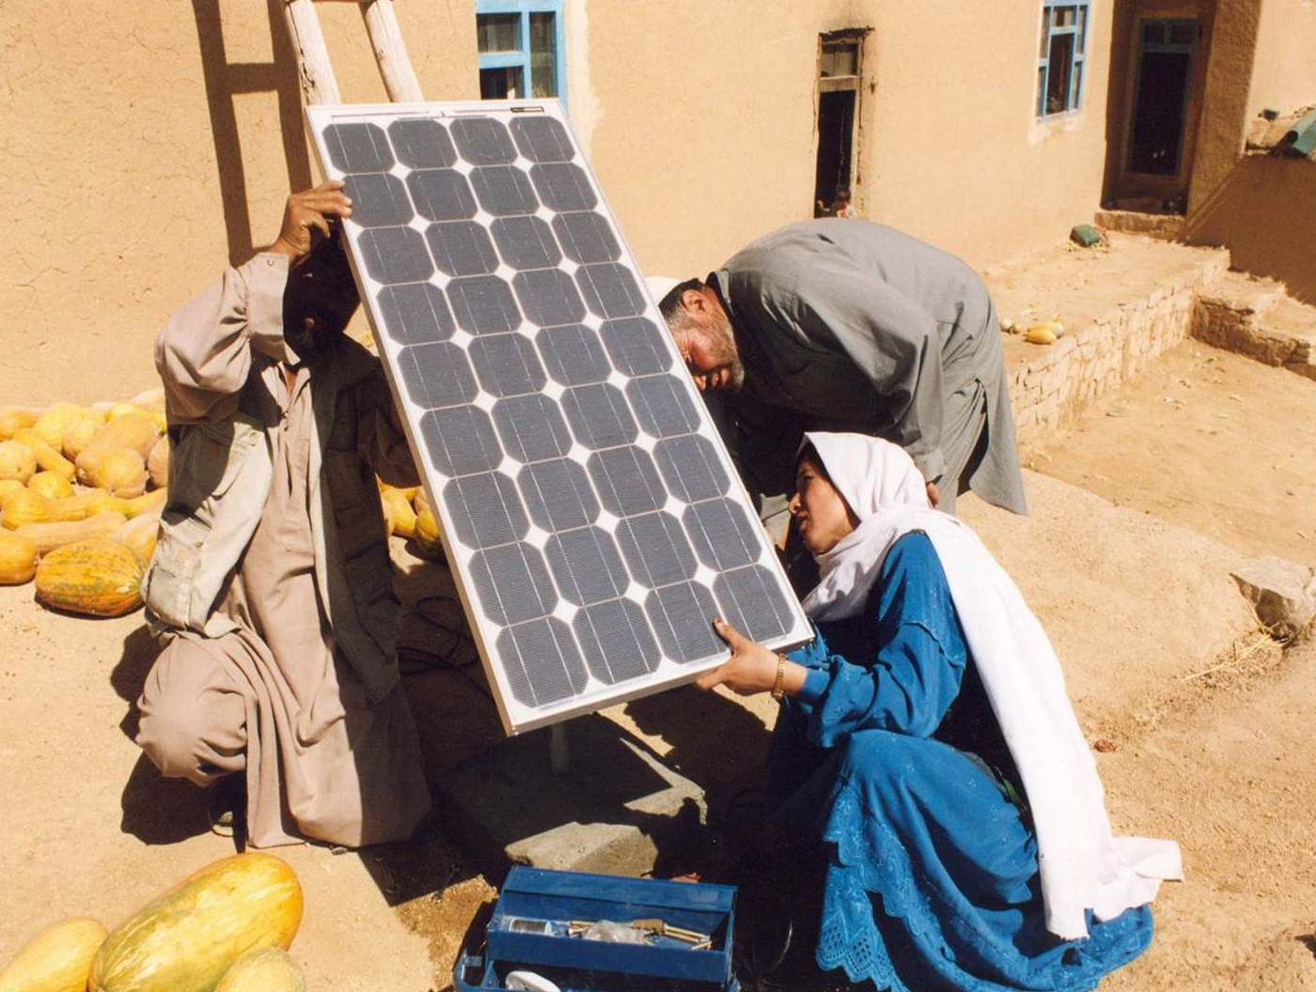
Findings Bamiyan
New perspectives of women’s abilities and knowledge
Women new space in political participation
BSEs installing solar in Dai Kundi (Photo: NCA)

Slide 12
Uttar Pradesh | Bamiyan
No income opportunities | Increase in income
Easier to undertake daily chores and childcare | Easier to undertake daily chores and childcare
Some women access to TV (restricted access) | Access to TV/Radio with WRGE information
Changed mobility with street light | Changed mobility with portable lanterns and outdoor lighting
No increase in women’s networking | More women solidarity and networking
No women role models as operators or committee members | Changed perspective of women’s abilities with women BSEs
 | Formalization of women’s political contribution through local council’s

Slide 13
NGO Perspectives UP and Bamiyan
Women are not interested
Women have no experience or education suitable
It is a good idea we are contemplation for future projects
Women can more easily fix equipment in houses when men are gone
Women are rooted in their community an keep the know how in the village
Illiteracy is no impediment the training is verbally

Slide 14
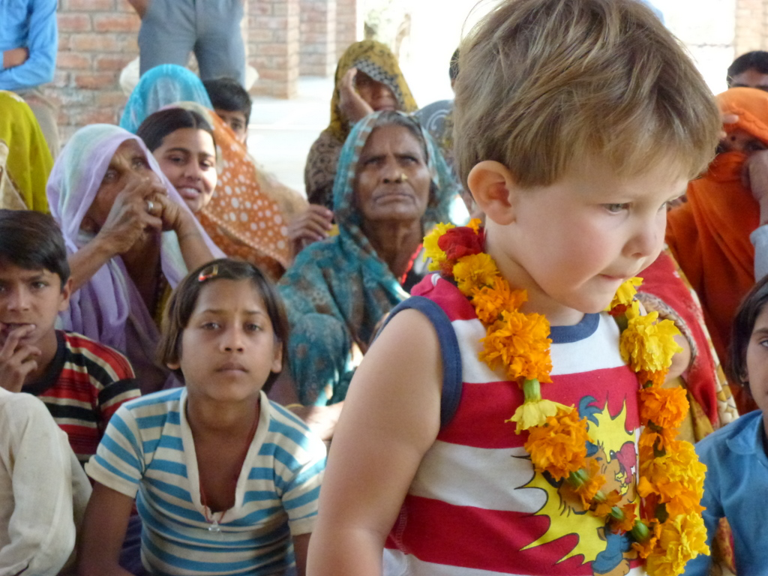
Thank you!
Karina.standal@sum.uio.no

