Slide 1
Analysing participation in development: framework and application to the Health Sector in Malawi
25 June 2013

Slide 2
Overview
Purpose of the study
Evidence and issues for participation
Methodological framework
Context for the Malawi pilot study
Approach to fieldwork
Findings on community perception of health services
Findings on participation and accountability
Constraints to participation
Implications

Slide 3
Purpose
Study emerges from concerns about tension between government and community “ownership”…
Overall objective of study to:
“Develop and pilot test a methodological framework that can be used by international development agencies (and others) to improve the understanding of the importance of local ownership and participation for aid effectiveness.”
Specific contribution to develop framework for classification and analysis of participation, and field testing, based on a typology and systematic analysis of types of participation… first step to understanding its effects

Slide 4
Participation: evidence and issues
Strong donor emphasis on “participatory approaches”, but lack of a clear assessment and conceptual framework, and some scepticism about value of the approach. Recent series of reviews of evidence:
Gaventa and Barrett: evidence on results of citizen engagement
Speer: evidence on participatory governance mechanisms
Mansuri and Rao: evidence on participatory project approaches
Conclusions: mildly positive experience with project approaches, stronger with citizen engagement (more “organic”)… but highly context dependent. Points to need for more detailed and systematic analysis

Slide 5
Methodological framework
Core of the methodological framework proposed for analysing the role of participation in programme effectiveness includes
Categories of participation - distinguished in relation to the main phases of the programme (or policy implementation) cycle.
Forms of participation - associated with different phases of the programme
Who participates? - (recognising that opportunities for participation may be structured by social and political conditions)
What are the motives for participation?
To what extent are preconditions for effective participation met?
What are the results of participation

Slide 6
Methodological Framework - Participation Matrix
Category of participation (across programme/policy cycle) | Form of participation [Examples listed] | Who participates and in what way? | What are their motives for participation? | To what extent are conditions for effective participation met? | What are the results of Participation?
Design, Policy-Making, Budgeting, Planning | Seeking to influence policy decisions (advising, advocacy, lobbying and activism): political parties, professional organisations, other civil society organisations active on specific issues, the media Local advisory committees, hearings processes to set priorities and plans Programme design
Implementation/ Service Delivery | Participation in campaigns, information sharing, awareness raising, volunteering
Monitoring and Evaluation | Citizen charters, social monitoring, community monitoring (e.g. of expenditure, drug availability, staff attendance), boards or oversight committees, complaint-making

Slide 7
Methodological framework
Complementing this matrix:
Understanding participation requires understanding the perceptions and expectations of potential participants. Relevant factors will include:
the information to which community members have access,
their understanding of their rights and ability to act on them, and;
local perceptions of service quality and concerns, which may differ from those reported through formal data systems.
The framework also needs to be informed by an understanding of the wider network of power relationships.

Slide 8
Methodological framework
Stakeholder mapping and political economy analysis can be used to explore these issues, focusing on
the appropriate disaggregation of stakeholders to analyse a particular intervention or issue (such as a particular form of participation);
identifying what are the most important power and resource flow relationships and how power is exercised in a particular institutional context; and
examining how stable these power relationships are and the factors that might lead to changes in the distribution of power.

Slide 9
Malawi Health Sector Pilot Study: context and issues
Designed as exploratory analysis of types of participation – not as evaluation of specific programme
Donor support to health focused on sector programme (support to HSSP). General improvement in health indicators, but uneven. Primary health care delivered through government and Christian Health Association of Malawi (CHAM) facilities
Malawi has undertaken some measures towards decentralisation to district level, but currently no elected local government, and most resource allocation decisions in health still determined at Ministry level
Social and political context is one of very limited (rural) community mobilisation, with inequalities in power reflecting hierarchies of education, wealth, gender and political connections

Slide 10
Study design and data collection
Study findings based on qualitative research using participatory tools in six districts and supplemented with stakeholder mapping and political economy analysis in two districts in each of three regions.
Detailed questions developed from research hypotheses and incorporated into participatory tools:
Social mapping
Community wellbeing analysis
Institutional mapping (Venn diagram)
Community Score Cards
Most significant change stories
Teams conducted Focus Group Discussions and Key Informant Interviews with communities, Health Surveillance Assistants, district officials, and members of local planning and health structures
Notes:
Social Mapping/ wellbeing analysis : (i) to map and analyse local social and physical infrastructure, including health services; (ii) to understand the characteristics of wellbeing in the community and perceptions of differences in well-being amongst the population including as it relates to access to health services; (iii) to prompt broader discussion on the community level health problems, availability & characteristics of health facilities, services and other related interventions.
Intititutional mapping: (i) to understand the importance and value attached to key institutions in the key community; (ii) to understand the nature and importance of social connectedness/exclusion among different groupings in relation to health; and (iii) to analyse social relations, networks/coalitions and motivations for civic engagement (or lack of civic engagement) with service providers

Slide 11
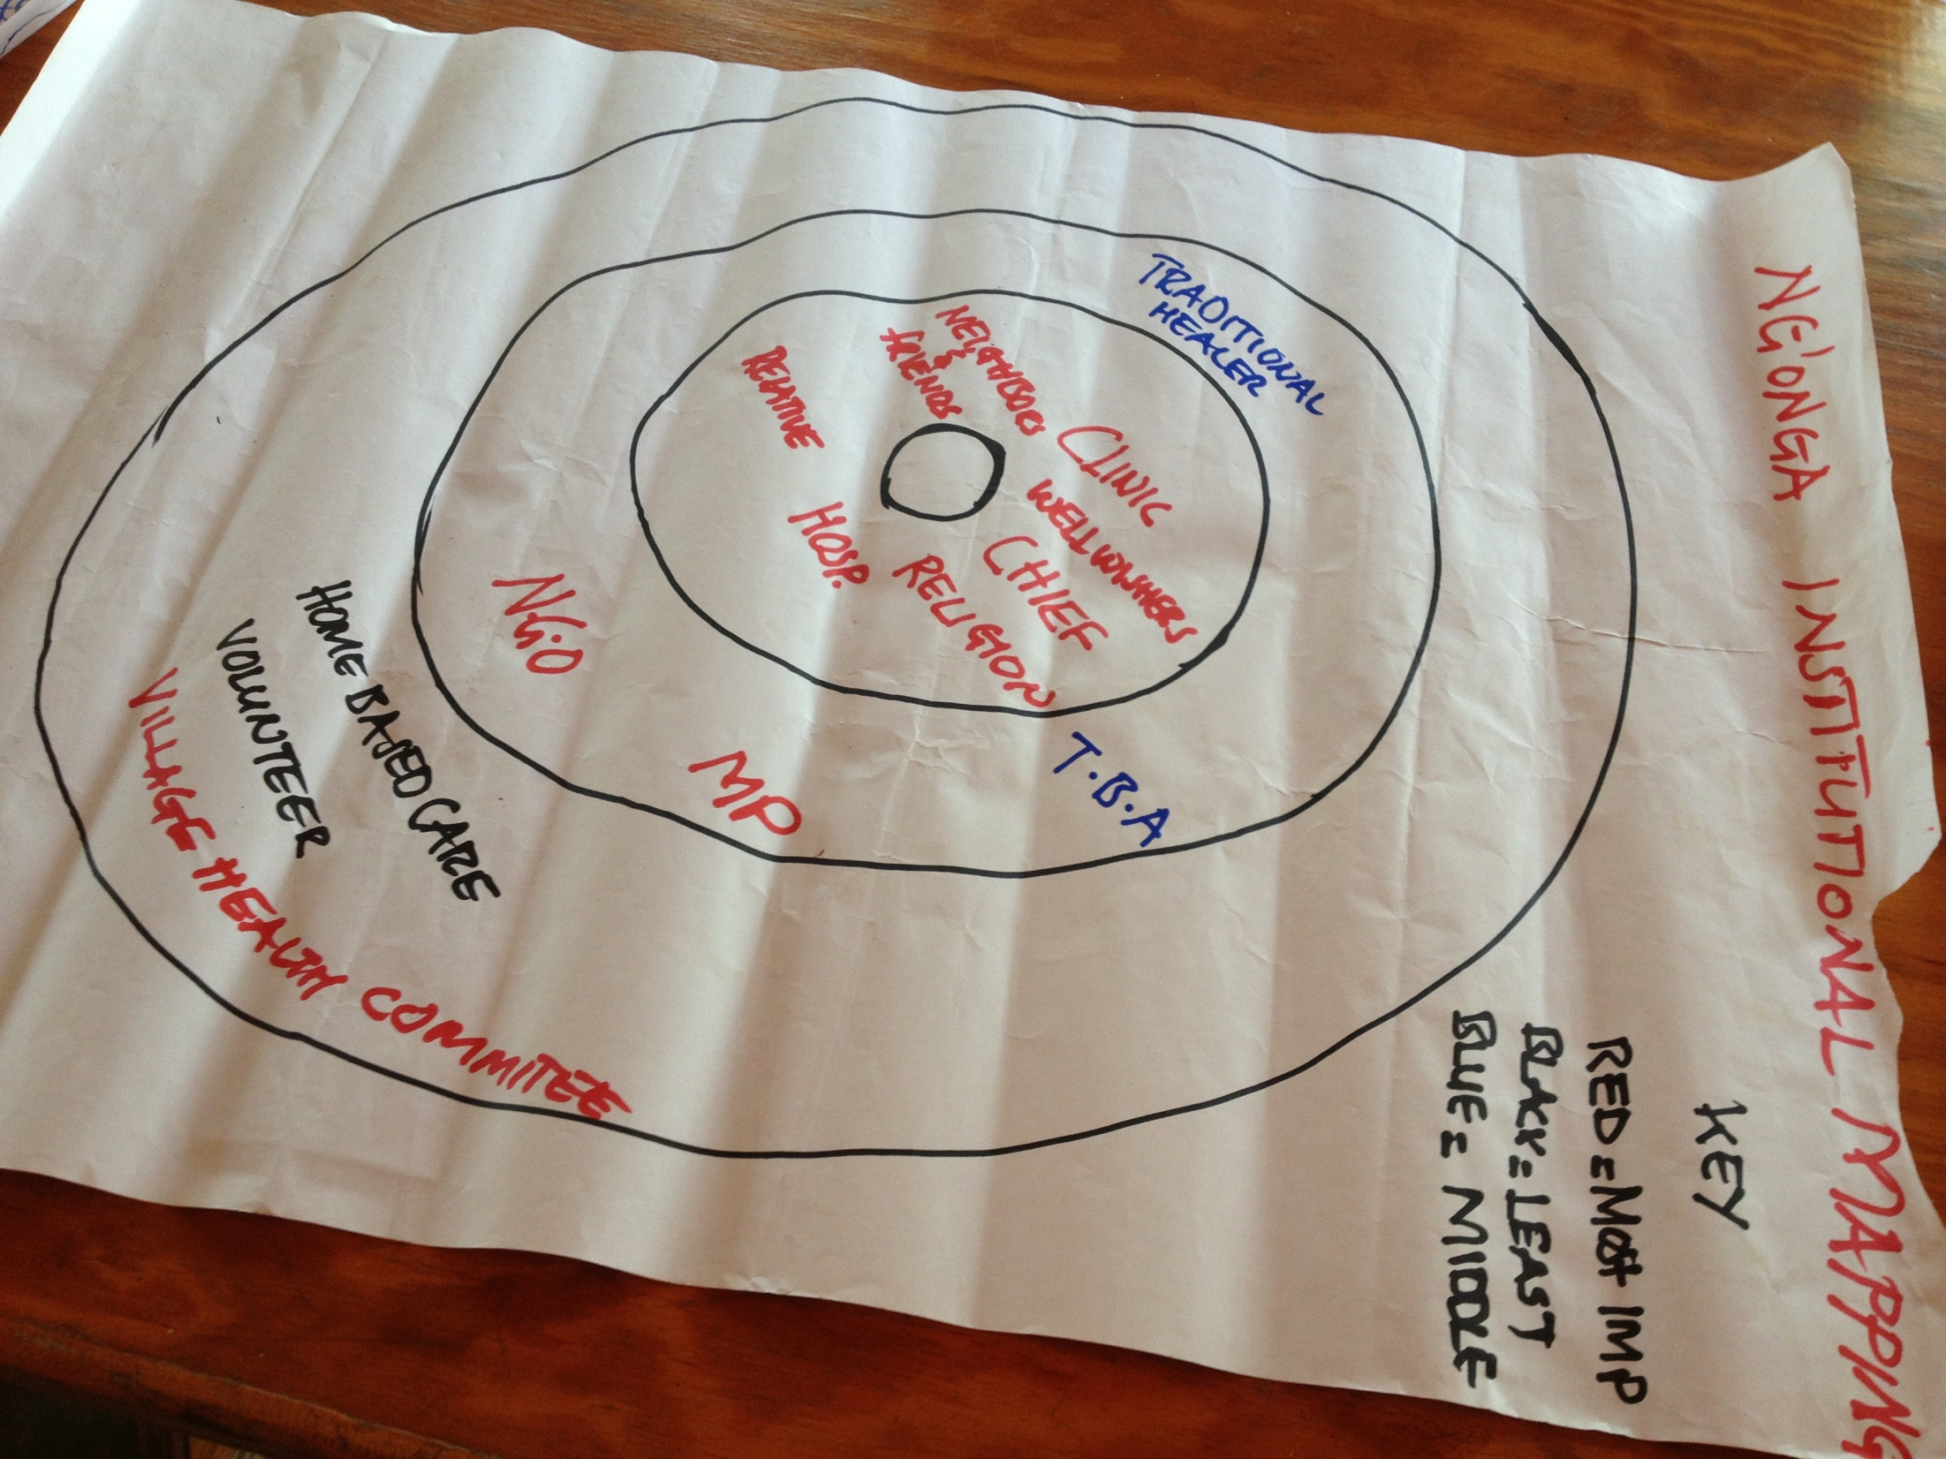

Slide 12
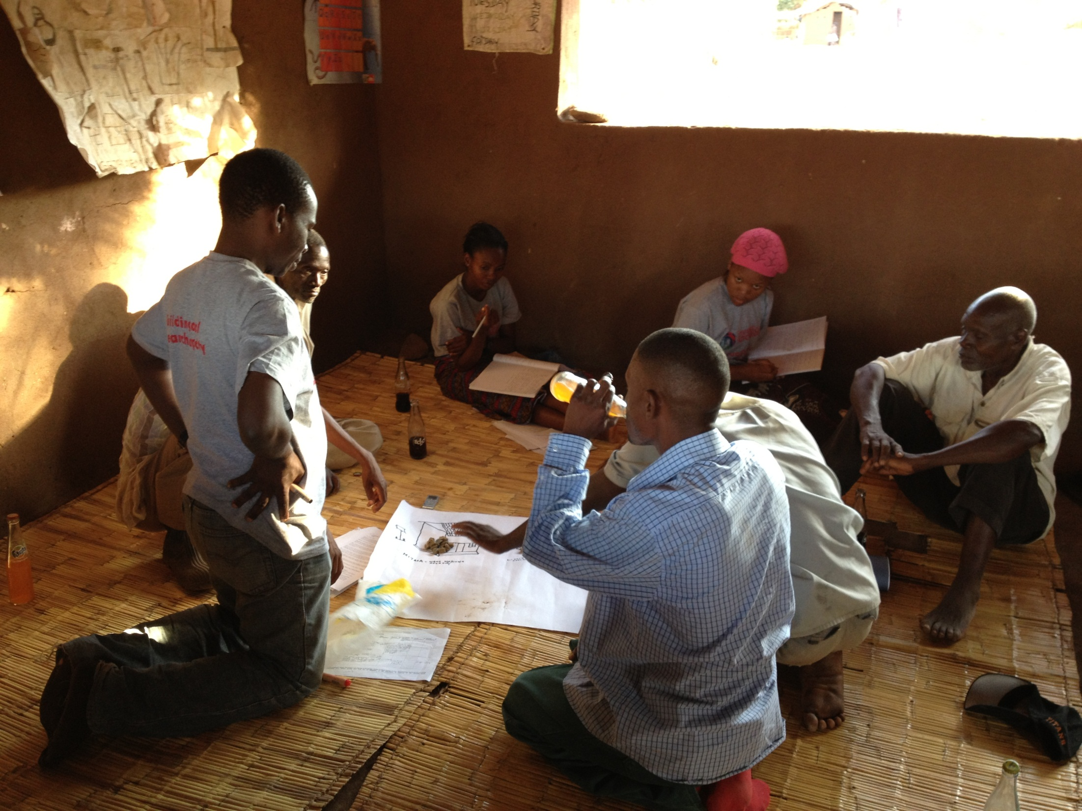
INSERT PHOTOS FROM FIELD WORK ON PARTICIPATORY TOOLS

Slide 13
Findings: Community perception of health services
Rights and information
Community members in rural Malawi had good understanding of rights in relation to health care, but these rights were seldom claimed
Information about rights through the radio, whilst information provided from other channels was primarily focused on prevention
Prevention information disseminated through range of sources (media, community outreach, churches), and shared formally and informally
Evidence that messages were heard and understood
Women played key role in dissemination of prevention information.

Slide 14
Community perception of health services
Disease and illnesses
Generally, communities were well aware of the diseases commonly afflicted with and their causes, especially the infectious and chronic diseases.
Most commonly stated diseases, based on the KIIs and the FGDs, were:
Malaria
HIV/AIDS
Diarrhoea
Respiratory Tract Infections
Malnutrition

Slide 15
Community perception of health services – sources of treatment
Access to and quality of services
Geographical proximity, costs and probability of getting good health care are some of the factors determining where to seek health
First point of call usually Government clinic or district hospital if close by. Government clinic one of the most important institutions for community members
HSAs first point of call for under 5s especially when living in village and when supplied with medication
Traditional healers sought over some ailments not cured through formal health care (but less prominent)
In catchment areas containing both CHAM and government clinics, CHAM perceived as better quality and better behaving staff and more available drugs, but costs a significant barrier to many.

Slide 16
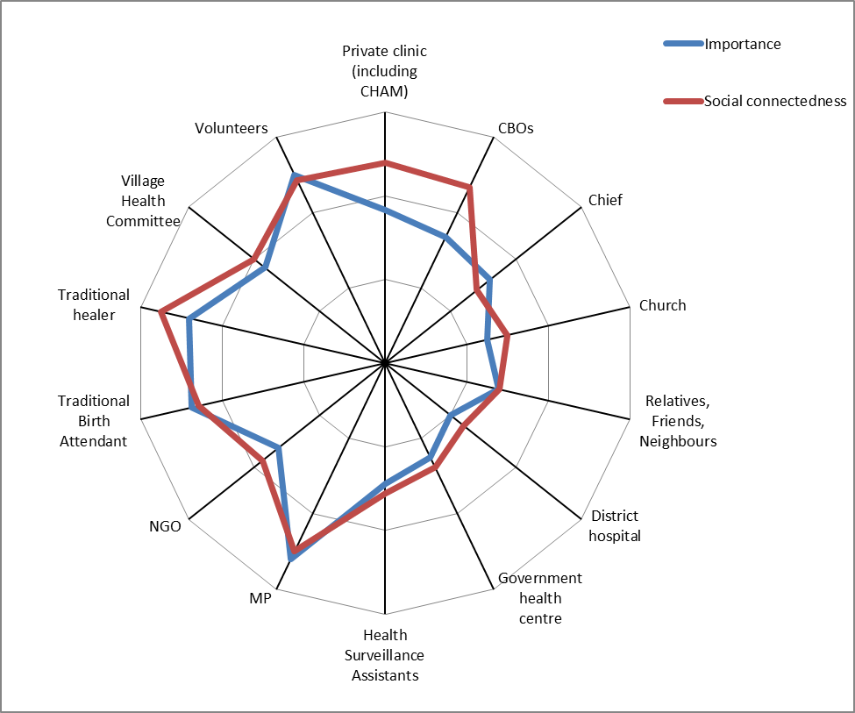

Slide 17
Community perception of health services – who is important
Findings from Institutional mapping exercise who is important (have knowledge, experience and resources to help) and socially close (accessible when you need them):
Government health facilities and district hospitals were ranked as very important and socially close in most FGDs;
Church and other informal social networks (friends, relatives, and neighbours) were almost always very important and very close;
HSAs were usually important and respondents felt socially connected to them;
CHAM facilities and private clinics important, but not socially close due to costs;
VHCs and individual volunteers were less important and not socially close to the respondents.
Traditional healers, TBAs and MPs were least important and socially distant.
Development aid effectively invisible at community level
Resources seen coming from the government or From NGOs delivering them

Slide 18
Participation in Policy, Planning, Budgeting and Programme Design
Community participation in policy and planning through Area Development Committees (ADC) and Village Development Committees (VDC)
The VDCs and ADCs met appeared to be motivated and responsive to community needs, though women’s representation, particularly at the ADC level, was minimal.
However, the significance of this system is undermined by the following factors:
The lack of discretionary resources that can be allocated or controlled at the District or lower level of government.
Political pressures for the equalised allocation of discretionary resources between geographical areas, which militates against district level planning on the basis of need.
The control of spending through cash releases that has, particularly in recent years, militated against coherent management of spending.

Slide 19
Participation in Policy, Planning, Budgeting and Programme Design
NGOs played an active role in many communities and were perceived as helpful… however communities did not feel they had influence over the priorities of NGO programmes or their design.
NGOs carry out consultation processes (informing community) but power relations (and the desire to access development resources) mean NGO priorities are rarely questioned.
Motivations for engagement with NGO programmes and processes are mainly driven by expectations of benefits (allowances, trainings)

Slide 20
Participation in Health Service Delivery
Community participation in health service delivery was primarily through volunteers working in the communities and sometimes in the health facilities.
The different types of participation included volunteering:
As Village Health Committees (VHC) members;
As community volunteers mobilised at the behest of HSAs or NGOs;
As a member of community based organisations;
Through religious congregations ; and
Through collective voluntary action for self hep projects, mobilised through the chiefs

Slide 21
Participation in Health Service Delivery
Motivation
People volunteered for a number of reasons:
“good heart”
religious calling
allowances and material benefits
prospect of new skills and new connections that might lead to a future jobs out of obligations and respect for the chief and community.
Underlying motivations for participation were found to influence the effectiveness and sustainability of participation

Slide 22
Participation in Health Service Delivery
Effectiveness
Forms of participation emanating from faith-based organisations were more likely to be effective and sustainable
Effectiveness of community volunteers depended on HSAs
The effectiveness of collective community action depended on the strength and behaviour of the local chief
Volunteers mobilised by NGO programmes less effective (motivation, lack of sustainable incentives)

Slide 23
Monitoring and Accountability
Accountability structures in health
There are clear monitoring and accountability structures governing the health sector at the district, sub-district and village levels in Malawi. These include
Ministry line management structures;
Local government administrative and political structures (DEC/DC/DCC);
Specialised health oversight committees (HCAC, Ombudsmen)
In addition to these NGOs support community monitoring of service providers and the traditional authorities serve as more informal monitors.

Slide 24
Accountability and Responsiveness
Community Participation in accountability
Community participation in monitoring and accountability occurs through citizens voicing their concerns and membership in oversight bodies monitoring the activities of the personnel in the health sector.
Rural Malawians complain about the health sector informally and formally.
Grumbling amongst friends and relatives
Official complains against serious maltreatment
Monitoring formally and informally
Spreading information when they see drugs, mosquitos nets or nutritional supplements arriving at clinics, or at shops
Membership of oversight committees
Notes:
They grumble in their informal social networks about the treatment they received at the health centre that day; it is only when they perceive serious mistreatment that they lodge a formal complaint through the government’s accountability structures — mainly the Health Centre Advisory Committee—or through a traditional leader. Moreover they may on rare occasions complain directly at the health facility.
Monitoring of health sector activities is also both formal and informal. When community members see government drugs, mosquito nets or nutritional supplements for undernourished children for sale at a shop, they spread the word through informal social networks. The formal monitoring activities are limited to monitoring drugs at the health clinic and distribution by HSAs. A selected community member of HCAC is meant to co-sign the delivery of drugs to the health facility and other community members (sometimes a member of VHC) monitor drug distribution by the HSAs at the village under-five clinics - when the drugs are provided through NGOs programmes.

Slide 25
Constraints on effective participation and accountability
Lack of genuine decentralisation of decision-making and of locally elected democratic institutions, as well as the very limited representation of women.
Lack of flexibility in donor programmes funding NGOs.
Motivation and competence of local health staff and traditional authorities
Power imbalances at local level (social, gender, education, political connections)
Weakness of supervision and effective sanctions in public health system
Lack of transparency about resource use and system performance
Lack of elected locally accountable representatives

Slide 26
Implication of findings
Implications for Government of Malawi
Lack of decentralisation of public resource allocation decisions undermines value of the local planning structures (here, the VDCs and ADCs) that have been created, though there is some local capacity.
Effective accountability to service users constrained by the weakness of supervision and management in the public health sector, including the lack of effective and credible sanctions for poor performance by staff.
Lack of systematic and regular monitoring and supervision of facilities, which would include close oversight of, and the provision of feedback on and response to, data from facilities.
Strengthening accountability requires enabling community members to act on their rights to services and good treatment, as well as improving the flow of information on how public resources for health are allocated and used.

Slide 27
Implication of findings
Implications for Donors and NGOs
Findings a challenge for donor action, since sector support from donors to the health sector is largely through existing government systems and processes which are biased against effective community participation. Support therefore likely to reinforce these biases, unless it is specifically designed to counter them.
Tempting for donors to respond to the challenges highlighted by bypassing currently relatively ineffective official processes, to work directly with communities. But study shows limitations of current forms of use and engagement with NGOs.

Slide 28
Proposed principles for enhancing participation in Malawi health
Support through NGOs needs careful design to reinforce participation and ownership and build capacity.
Stronger understanding of formal and informal structures through which communities engage and participate is required.
Sustainable participation likely to be rooted in existing social organisations and networks, and formal structures of budgeting and planning.
Strengthening in planning and budgeting requires discretion over resources at local level and enhanced oversight of how resources used.
Such initiatives need careful design to enhance accountability.
Strengthening participation in service delivery should build on existing community-led structures and initiatives.
Improving effectiveness and accountability of health service provision requires strengthened management in the public system.
Improving ability of communities to monitor use of resources requires greater transparency in information.

