Slide 1
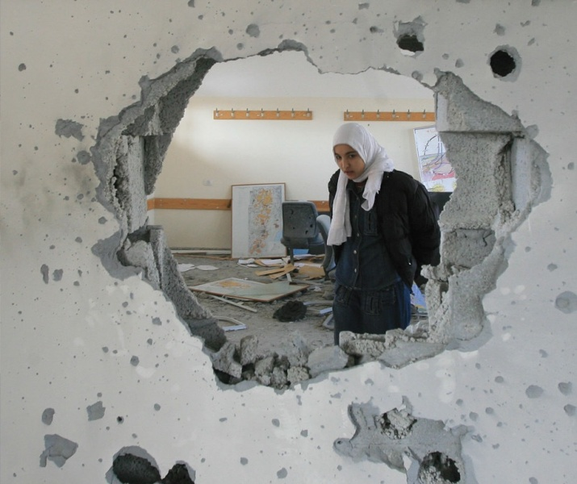
Conflict Sensitive Education Pack : Integrating Conflict Sensitivity in Education Programmes, Planning and Policies
Seminar:
Education and Conflict: the Past, Present and Future Role of Norway’s Engagement
Naoko Arakawa,
Coordinator for Education and Fragility Working Group, INEE

Slide 2
Inter-Agency Network for Education in Emergencies (INEE) & Working Group on Education and Fragility (WGEF)
INEE :
Open, global network of 10,000+ members in 170 countries
3 Working Groups, 6 Task Teams, 4 Language Communities
Recent Highlights : Global Consultation and EiE Journal
WGEF:
Established in 2008, 27 member organizations
Developed Conflict Sensitive Education Pack with the Working Group on Minimum Standards.
Analysis identified: Absence of conflict sensitive tools/ frameworks & key gaps & similarities.

Slide 3
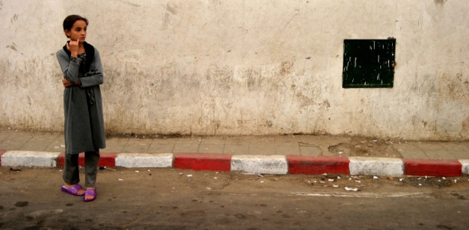
Why Focus on Conflict Sensitive Education?
1. Access to quality education is a human right
The Universal Declaration of Human Rights 1984
The Fourth Geneva Convention, etc.
2. The right to education is not being fully realized
Half of the world out-of-school primary aged children are in conflict-affected or fragile contexts
Education – only 1.4% of humanitarian aid
3. Education and conflict have a bi-directional and complex relationship
Education can contribute to conflict & also peacebuilding
4. Education programs and policies in conflict-affected and fragile contexts should be conflict sensitive
Minimize negative impacts and maximize positive impacts

Slide 4
What is Conflict Sensitive Education?
The process of:
1. Understanding of the conflict context
2. Analyzing the two-way interaction between the conflict context and education programmes and policies
3. Acting to minimize negative impacts and maximize positive impacts of education policies and programming on conflict
Adapted from http://www.conflictsensitivity.org
Notes:
This definition can be found on the INEE website: ineesite.org/education-fragility/conflict-sensitive-education

Slide 5
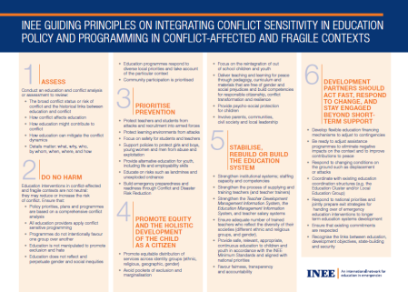
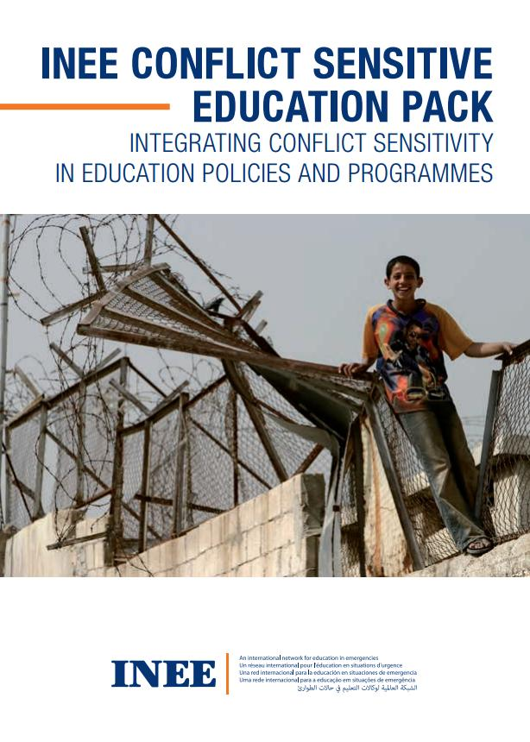
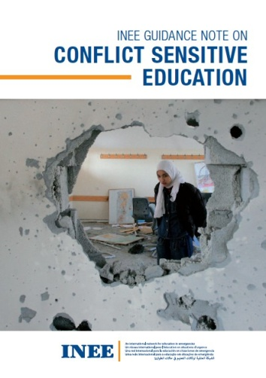
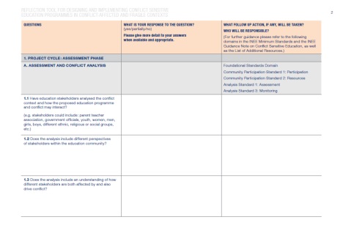
Conflict Sensitive Education Pack
Guiding Principles
Guidance Note
Reflection Tool

Slide 6
CSE Pack – (1) Guiding Principles
Who is it for? For all stakeholders concerned with education in CAF contexts (policy makers, practitioners, Ministries of Education, donor agencies, UN agencies and other implementing partners)
What can it be used for?
Ensuring conflict sensitivity is incorporated in education proposals, national education policies and programmes as standard practice.
Showing your commitment to prioritize conflict-sensitive education.
Awareness raising and advocacy.

Slide 7
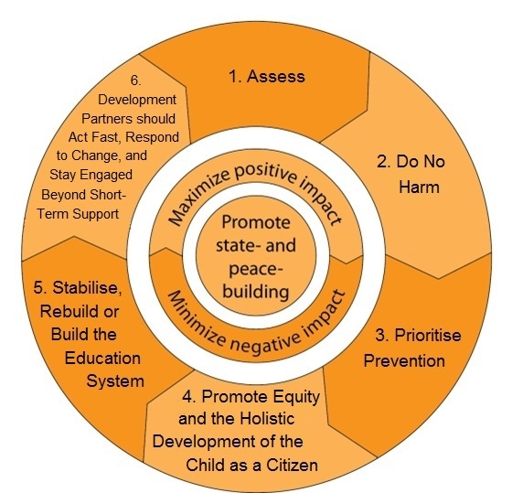
CSE Pack – (1) Guiding Principles
(Continued)
6 Principles

Slide 8
CSE Pack – (2) Guidance Note
Who is it for? For all stakeholders concerned with education in CAF contexts
What can it be used for?
Learning key concept of conflict-sensitive education
Learning comprehensive strategies for developing and implementing conflict-sensitive education programs and policies at all levels and in all types and phases of conflict
Capacity building of practitioners and policy makers on key concept and strategies
Using case studies, conflict analysis sample questions, and a quick reference tool
Framework Use INEE Minimum Standards (5 domains)

Slide 9
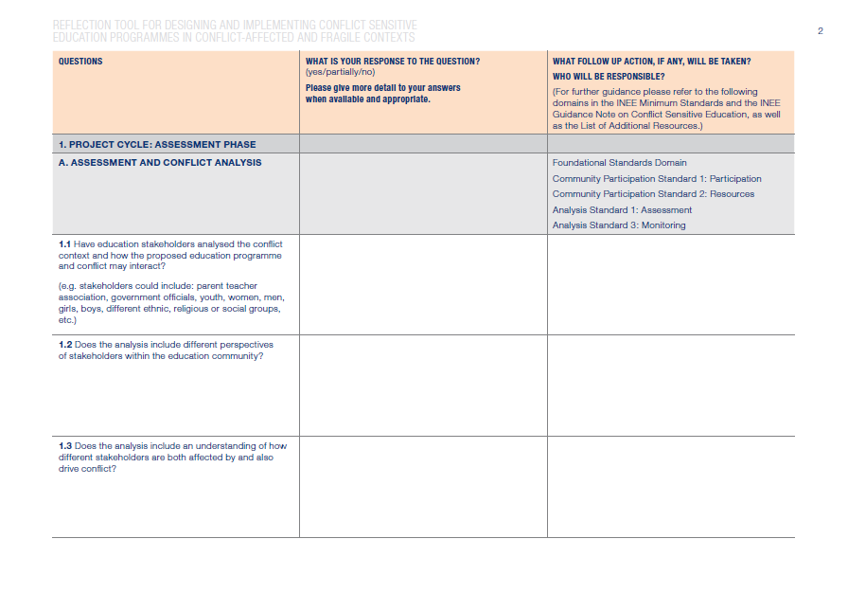
CSE Pack – (3) Reflection Tool
Who is it for? Particularly for education programme staff and other stakeholders concerned with education in CAF contexts.
What can it be used for?
Ensuring conflict sensitivity is integrated in education at all stages of the project/programme cycle.
Particularly useful as a practical “check-list” for field based staff to design, assess, monitor and evaluate implementation at all the stage of project/programme cycle.
Reflection Tools was tested in 6 organizations in 5 countries.

Slide 10
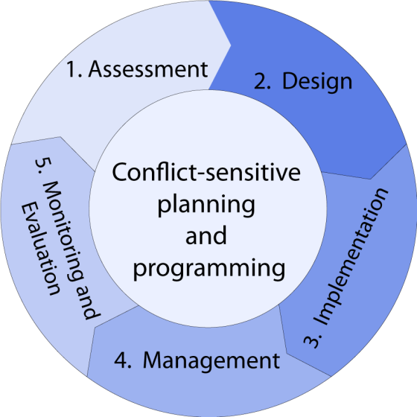
CSE Pack – (3) Reflection Tool
(Continued)

Slide 11
Applies Across Education Sector
Conflict Sensitive Education
Student
Classroom
Education System(s)
(Polices & Strategies & Planning)
School Community/Learning Environment
Geographic Programme Area/District
©Cynthia Koons

Slide 12
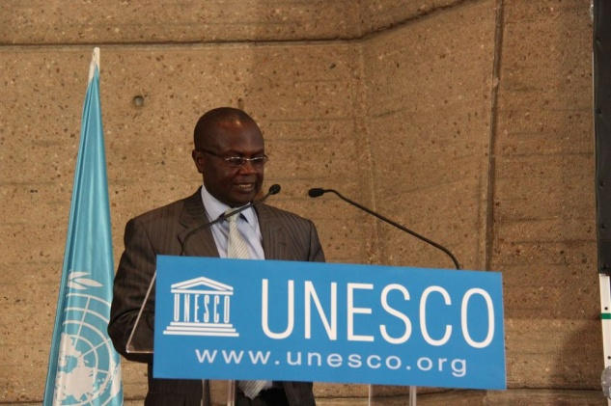
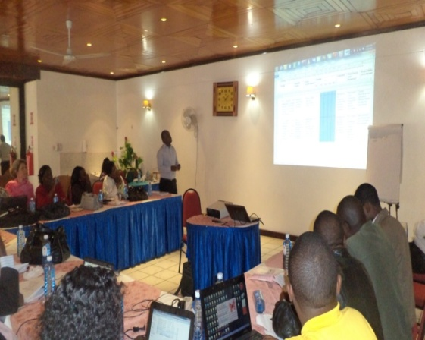
Application in Practice
Paris High-Level Symposium Launch
GIZ shared the pack at its internal “Global Network on Education & Youth” meeting as well as international meetings for using in countries such as Afghanistan and Pakistan.
Save the Children & FHI360 launched and trained practitioners.
Plan International is going to use the Pack with adjustment in South Sudan and Mali programmes.
UN Interagency FT for Preventive Action team shared the Pack with the UN OCHA Eastern Africa Education Sector Coordinator.
Ministry of Education in Kenya
Integrated into the education sector policy on peace education.

Slide 13
For Further Information
INEE Website
ineesite.org/conflict-sensitive-education
INEE Toolkit
toolkit.ineesite.org/conflict_sensitive_education
Conflict Sensitive Education
ineesite.org/en/education-fragility/conflict-sensitive-education
Share your experiences on CSE with us! educationfragility@ineesite.org

